Slide 1

AquaSpace
Ecosystem Approach to making Space for Sustainable Aquaculture
Kick-Off Meeting
Work Package 2 Description
Industry-wide Issues and Options
Overview: Joao G. Ferreira, Jeremy Gault , Richard Corner
Contributions: SAMS, BF, FAO, NARIC, IMR, JHI, LLE, TI-SF, UCC, DAL, NOAA
Scottish Association of Marine Science
Oban, Scotland, March 2015

Slide 2
AquaSpace Industry-wide Issues and Options (WP2)
Outline of talk
Overview and context
Policy-management
Aquaculture-environment
Aquaculture-other sector interactions
Economic and market issues
Final comments
Connectivity and disease risk modelling
http://longline.co.uk/aquaspace

Slide 3
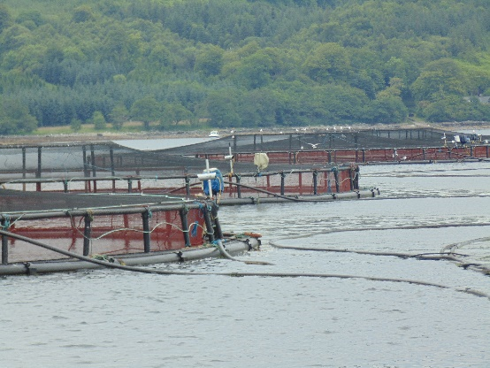
Objectives of WP2
Framework to research and summarise key issues constraining the growth of aquaculture in Europe: inland, coastal, and offshore;
Policy and management aspects, environmental suitability, co-use, and market issues;
Specificities of different aquaculture segments and regional diversity of aquaculture in Europe and elsewhere.
Work on key issues for industry is essential for development of solutions.

Slide 4
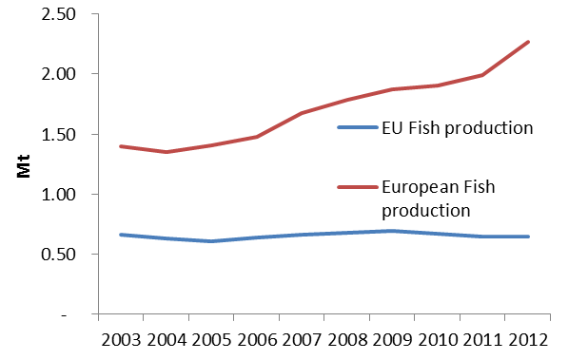
Status and trends in European aquacuture
EU runs13 billion € negative annual trade balance for aquatic products;
EU: World production has fallen from 7.9% in 1990 to 1.9% in 2012;
Bivalves are 20.1% of world aquaculture, EU: 56.6% & Europe 24.7%;
Extra 30 million tonnes of aquatic products needed annually by 2050.
EU production needs to grow but also to rebalance finfish and shellfish.

Slide 5
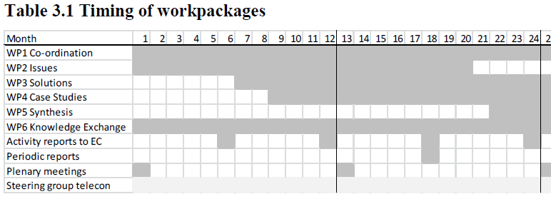
AquaSpace Work Package 2
Industry wide issues and options
MS4
MS5
D2.1
D2.2
D2.3
D2.4
MS11
MS12
D2.5
MS8
MS9

Slide 6
AquaSpace Work Package 2
Industry wide issues and options
Tasks:
  T2.1 Assessment of Policy-Management Issues (UCC).
    EAA, MSP, MSFD, WFD? Approaches, barriers and issues, regional workshop.
  T2.2 Quantitative assessment of aquaculture-environment issues (LLE).
    WQ, hydrodynamic and other env. criteria that limit special use for species, analysed through a relational database and GIS applications.
  T2.3 Assessment of aquaculture-other sector issues (FAO).
    Limitations & conflicts posed by other uses of M and FW environs.
  T2.4 Assessment of economic-market issues (LLE).
    Limitations imposed by set-up and running costs, longevity, global markets, profitability, land use and logistics.

Slide 7
AquaSpace Work Package 2
Industry wide issues and options
Key Deliverables:
  D2.1 Compound review of issues related to T2.1, 2.2, 2.3 and 2.4 for marine-based culture (Month 12, Feb. 2016).
  D2.2 Same for freshwater-based culture (Month 12, Feb 2016).
  D2.3 Online policy-management application (Month 15, May 2016).
  D2.4 ‘Investor appeal’ App (Month 15, May 2016).
  D2.5 Online environmental feasibility App (Month 20, Oct 2016).
  D2.3 and D2.4 : Release will be months 18 (Oct 2016) and 21 (Jan 2017) respectively
Adjustment because a significant part of the GIS work will take place in 2016.

Slide 8
AquaSpace Work Package 2
Industry wide issues and options
Key Milestones:
  MS4: Month 4 (June 15) – Regional workshop
  MS5: Month 8 (Oct 15) – report outcomes from workshop to other WP’s.
  MS8: Month 13 (Mar 16) – Usability tests, on-line Policy-Man. web application.
  MS9: Month 13 (Mar 16) - Technical approval of on-line Environmental feasibility web application.
  MS11: Month 15 (May 16) – Release of on-line Policy-Management application web application.
  MS12: Month 15 (May 16) – Release of “Investor Appeal” app.
  MS15: Month 20 (Oct 16) – Release of on-line Environment feasibility web application.
  MS11 and MS15: Release will be months 18 (Oct 2016) and 21 (Jan 2017) respectively
Adjustment because a significant part of the GIS work will take place in 2016.

Slide 9
Policy-Management Issues
Jeremy Gault;
Karen Alexander;
Joao G. Ferreira;
Jose Aguilar-Manjarrez.
Perspectives, past experience, and plans for AquaSpace.

Slide 10
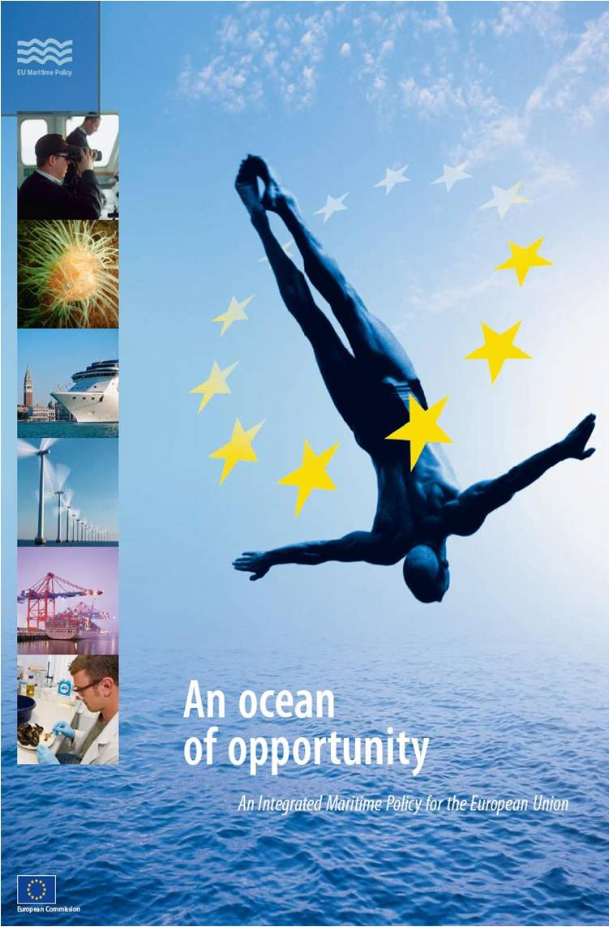
Task 2.1: Assessment of Policy-Management Issues
Background:
EU Integrated Maritime Policy - Blue Growth, Sea Basin Strategies, National Policies
Marine Strategy Framework Directive
EU Maritime Spatial Planning Directive
Common Fisheries Policy Reform package
Nature protection Directives and policies to halt loss of biodiversity and ecosystem services
Water Framework and Floods Directives
EU Climate Change Adaptation Strategy
Current / Future Funding (FP7, ESA, H2020)
Sectoral, cross-cutting policies: energy, transport, regional policies, etc.
[Integrated Coastal Zone Management (EU ICZM Recommendation)]
Notes:
10

Slide 11
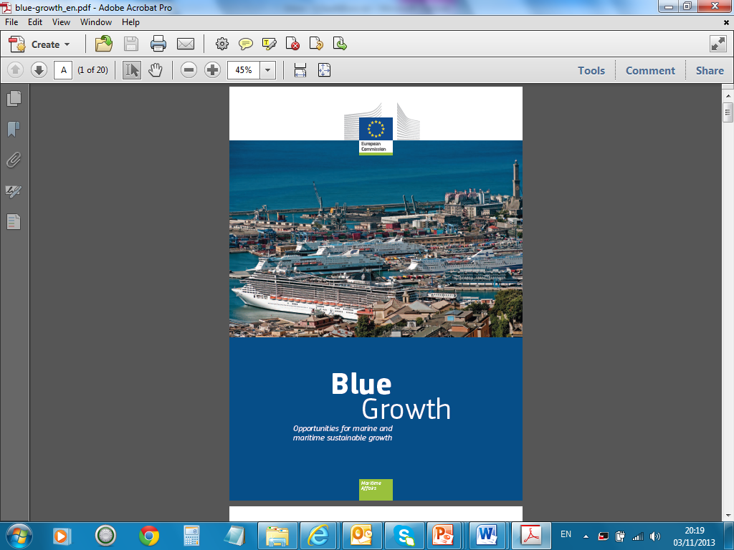
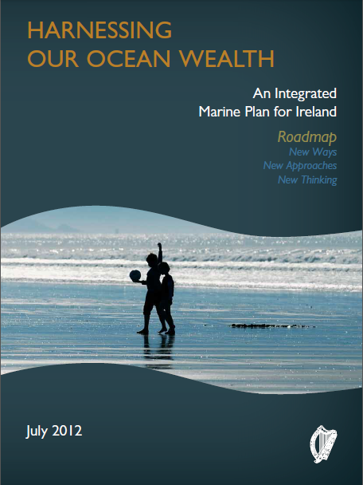
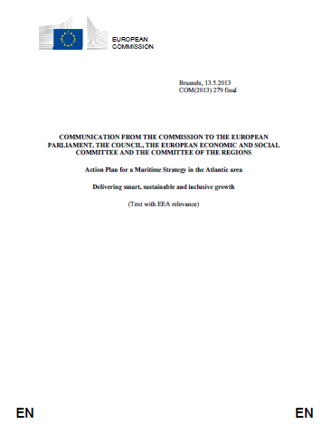
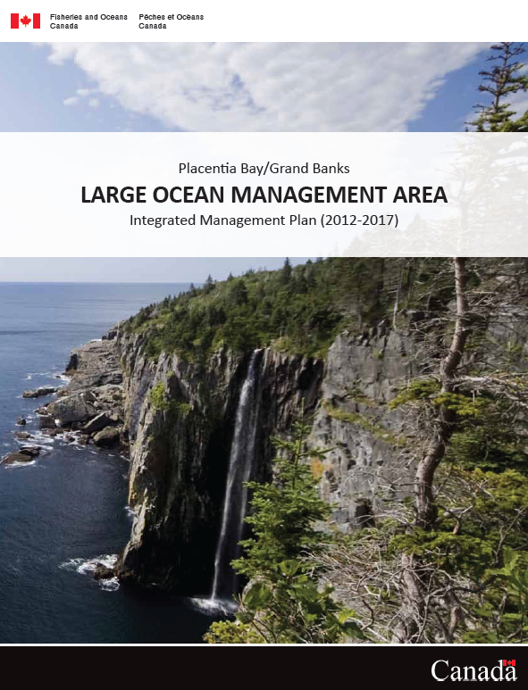
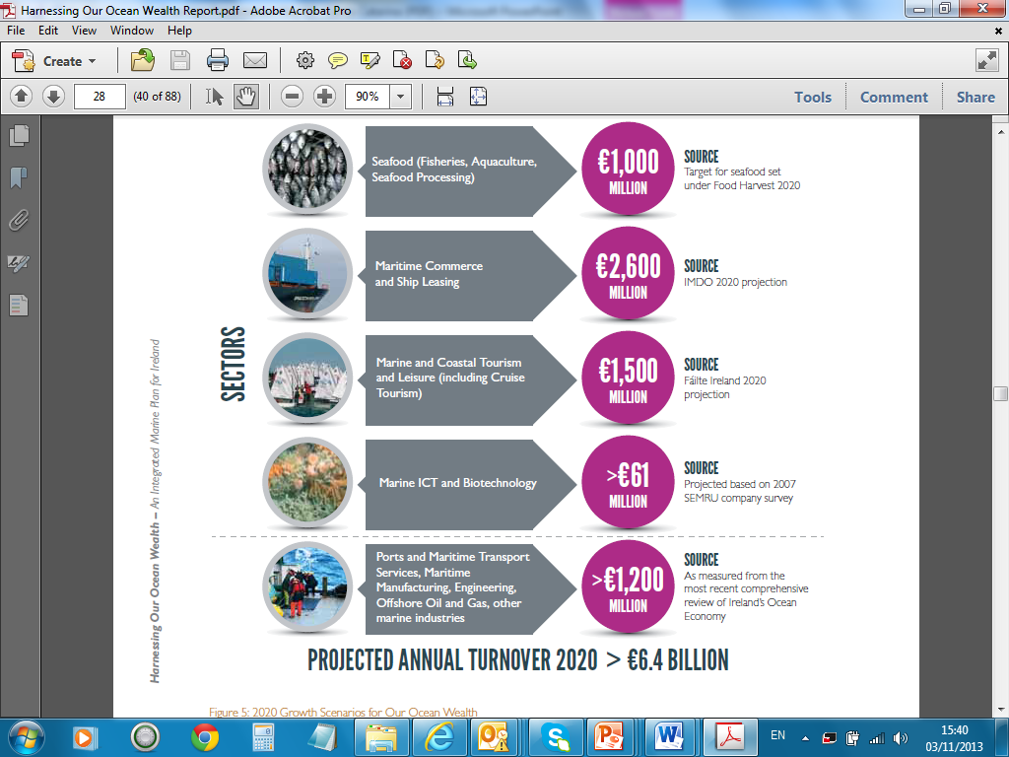
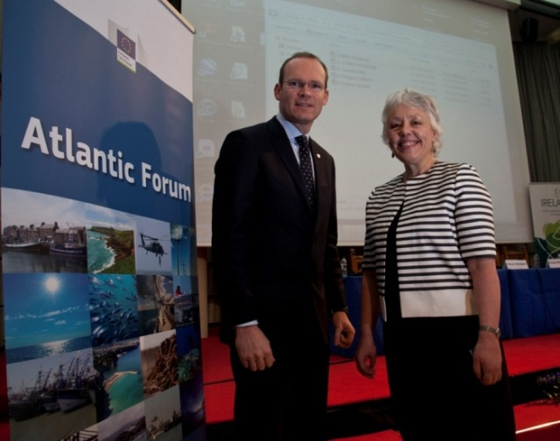
Task 2.1: Assessment of Policy-Management Issues
Policy Context:
Thriving Maritime Economy
Sustainable economic growth of our marine/ maritime sectors
Increase the contribution to our national GDP
Deliver a business friendly yet robust governance, policy and planning framework
Healthy Ecosystems
Protect and conserve our rich marine biodiversity and ecosystems
Manage our living and non-living resource in harmony with the ecosystem
Implement and comply with environmental legislation
Engaging with the Sea
Building on our maritime heritage, strengthen our maritime identity
Increase our awareness of the value, opportunities and societal benefits
Engagement and participation by all
Healthy Ecosystems
Conserve Coldwater Coral and Sponge Reefs
Prevent Introduction/Distribution of Aquatic Invasive Species (AIS)
Rebuild Atlantic Cod
Manage Habitat for Marine Species
Protect at Risk Species and Vulnerable Marine Habitats
Collaborative and Effective Governance
Conduct a Legislative and Regulatory Gap Analysis
Enhance Communication and Awareness
Identify and Address Information and Data Needs/Gaps
Mitigate and/or Prevent Conflict
Sustainable Use
Improve Coastal and Marine Infrastructure
Prevent Pollution
Assess Linkages, Opportunities and Values to Guide Economic Development
Foster Community Engagement
Promote Education and Stewardship

Slide 12
Task 2.1: Assessment of Policy-Management Issues
Description:
Conduct a regional review of current approaches to spatial planning, identifying major gaps, barriers to implementation, and the main steps for conforming to the Ecosystem Approach to Aquaculture (EAA) [Deliverable 2.1 – Regional review on Policy Management in Mariculture Month 12 / Feeds into Deliverable 2.2 Regional review on Policy-Management in freshwater aquaculture]
This will consider Aquaculture with respect to the environment (Task 2.2) and Aquaculture with respect to Other issues (Task 2.3) / Users and market issues (Task 2.4)
Present final draft review for discussion in a regional workshop [MS4 – note Month 4 – timing?] attended by internationally recognised experts from academia, regulatory authorities, consultants, and regional stakeholders Selection of Workshop attendants will be closely coordinated with T6.1: Establish a User Reference Group of Stakeholders from Key Organisations (see WP6 Pres.)
Need to link to H2020 other projects [e.g. MARIBE-Marine Investment for the Blue Economy, RICORE - Risk Based Consenting of Offshore Renewable Energy]

Slide 13
Task 2.1: Assessment of Policy-Management Issues
Maritime Spatial Planning Directive (MSP):
MS shall identify the spatial and temporal distribution of relevant existing and future activities and uses in their marine waters
Interests may include:
  Aquaculture and fishing areas
  installations and infrastructures for the exploration, exploitation and extraction of oil, gas and other energy resources, minerals and aggregates and for the production of energy from renewable sources
  maritime transport routes and traffic flows
  military training areas
  nature and species conservation sites and protected areas
  raw material extraction areas
  scientific research
  submarine cable and pipeline routes
  tourism
  underwater cultural heritage

Slide 14
Task 2.1: Assessment of Policy-Management Issues
Strategic Guidelines for the sustainable development of EU aquaculture:
Communication from 2013 (COM(2013) 229 final)
CFP Reform Package wishes to promote aquaculture through “an open method of coordination”:
  A voluntary process for cooperation based on Strategic Guidelines and
  Multiannual national strategic plans with common objectives and progress indicators, where possible
Establishment of an Aquaculture Advisory Council at EU-level [ref Task 6.1]
Four Priority Areas:
Simplify administrative procedures
Member States were asked to report to the Commission on number of licences applied for, success rated, time taken, agencies involved and costs by the end of 2013,
Commission to report on best practices and margins for improvement by Summer 2014
Aquaculture Advisory Council to perform a mapping exercise and outline of applicable administrative procedures (and burdens) for each type of aquaculture by April 2014

Slide 15
Task 2.1: Assessment of Policy-Management Issues
Strategic Guidelines for the sustainable development of EU aquaculture:
2. Secure sustainable development and growth of aquaculture through coordinated spatial planning
Member States to put in place coordinated spatial planning which includes aquaculture and its spatial requirements on land and at sea
Commission to disseminate experiences on MSP to help implementation at MS level
3. Enhancing the competitiveness of EU aquaculture
Member States to improve links between R&D and the industry, to utilise the Common Market Organisation (CMO) and new European Maritime and Fisheries Fund (EMFF) to support aquaculture development, marketing and production plans
The Commission is to coordinate and support research and innovation for aquaculture through all the relevant EU programmes and funds and transfer lessons learned from any relevant projects

Slide 16
Task 2.1: Assessment of Policy-Management Issues
Strategic Guidelines for the sustainable development of EU aquaculture:
4. Promote a level playing field for EU operators by exploiting their competitive advantages
Member States to ensure the sustainability of EU aquaculture projects are communicated effectively to the public (e.g. dedicated labelling schemes etc.)
The Commission is tasked with improving market transparency and to disseminate information on trends at local, EU and international levels. Also to launch a campaign on the strengths of EU aquaculture by the end of 2013
Aquaculture Advisory Council to improve market intelligence, promote self-regulatory initiatives among producers and communicate with consumers
Strategic Guidelines: Multi-annual plans:
Member States required to produced multiannual national strategic plan for aquaculture based on these Strategic Guidelines
Multiannual national plans will cover the period 2014-2020
Member States are encouraged to undertake a mid-term review of the implementation of their plan by the end of 2017
Template for multi-annual plan provided in the strategic guidelines (Annex 1)

Slide 17
(i) Policy-Management Issues
Licensing process complex, occurring across different levels (national & regional) and between different institutions
  Influenced by local/regional/national policy
  Process, and guidance, can differ between regions
  Little communication between, and even within, licensing institutions

Slide 18
European directives
Water Framework Directive (WFD, 2000/60/EC) regulates water quality in all EU surface waters, but considers aquaculture only as a pressure;
Marine Strategy Framework Directive (MSFD, 2008/56/EC) guidance for Descriptor 3, Commercial Fish and Shellfish Populations, completely ignores aquaculture;
European Maritime and Fisheries Fund (EMFF) refers to aquaculture over one hundred times;
EU Member-States must present sector plans with a 2020 horizon for expansion, but the tools for a realistic assessment are lacking.
AquaSpace should examine these issues—without legislative harmonization expansion is not possible.

Slide 19

GFCM REVIEW & spatial planning to Promote sustainable aquaculture growth
Dr. José Aguilar-Manjarrez
FAO Aquaculture Branch
Rome, Italy
March 23-25, 2015
(Oban, Scotland)

Slide 20
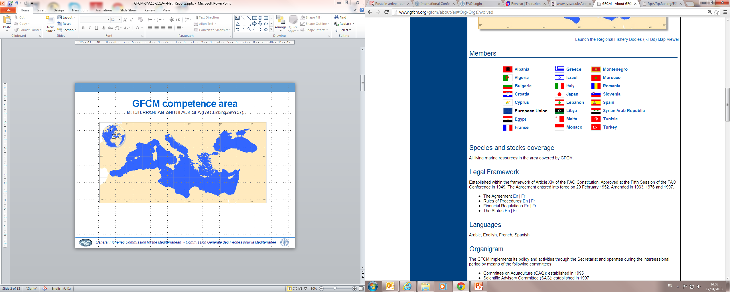

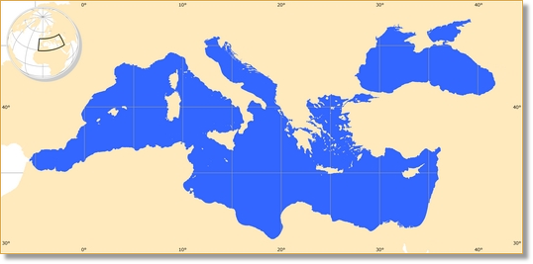
GFCM - factsheet
1949 Constitutive Agreement under FAO Article XIV (RFMOs)
Competence over the Mediterranean and Black Sea and connecting waters
Power to adopt binding decisions
24 Members: 3 Black Sea, 19 Med, Japan and EU (open membership)
Annual session, intersessional work done by subsidiary bodies and coordinated by the Secretariat
Steering provided by a Bureau composed of a Chairperson and 2 Vice-Chairpersons
Autonomous budget
Strong coordination and liaison with the FAO Fisheries Department
Objectives
Ensure the long-term sustainability of living marine resources, the sustainable development of aquaculture and the protection of sensitive marine habitats and ecosystems
Notes:
Commission membership is open to Members of the United Nations, especially coastal States, States whose vessels engage in fishing in the Convention Area as well as to Regional Economic Integration Organizations.
The GFCM holds its regular session annually
The Commission normally holds its Regular Session on an annual basis and convenes special sessions, as appropriate, at the request or with the approval of the majority of the Members. It seeks to promote the conservation and rational management of living marine resources through, inter alia, drawing up binding measures related to the regulation of fishing methods, fishing gear and minimum landing sizes, together with the establishment of open and closed fishing seasons and areas. It also strives to implement a fishing effort control regime by Operational Units through the regulation of catch and fishing effort and their allocation among Members.
Sessions of the Commission are attended by delegates, their alternates, experts and advisers. Each Member has the right to one vote except in the case of a Regional Economic Integration Organization (REIO) which is entitled to the number of votes equal to the number of its Member States which are also Members of the Commission. Competence and voting power over specific Session issues are indicated by REIOs prior to the Session; REIOs cannot exercise their votes when their Member States exercise theirs and vice versa.
It implements its policy and activities through the Secretariat based at its headquarters in Rome, Italy
It operates during the intersessional period by means of its committees and their respective subsidiaries:
the Scientific Advisory Committee (SAC)
Provides independent advice on the conservation and management of fisheries, considering biological, ecological, economic and social aspects.
the Committee on Aquaculture (CAQ)
Monitors trends, promotes sustainable development and responsible management of marine and brackish water
Aquaculture and provides related independent advice on technical, socio-economic, legal and environmental grounds.
the Compliance Committee (CoC)
Reviews the compliance with conservation, management, monitoring, control, surveillance and enforcement measures adopted by the Commission, oversees the development and implementation of the GFCM Control and Inspection scheme and reviews issues such as IUU fishing in the Convention Area.
the Committee of Administration and Finance (CAF)
subsidiary committees of SAC, CAQ and CoC
other temporary, special or standing committees and working parties
The GFCM also enjoys the support of cooperative projects at sub-regional and regional level which enhance, in particular, scientific cooperation and capacity building in participating countries in line with GFCM priorities and strategies
It cooperates closely with other international organizations in matters of mutual interest

Slide 21
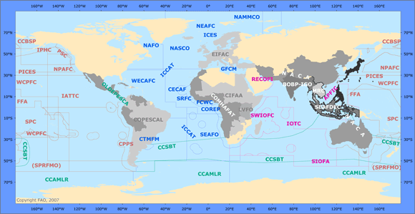

Regional Fisheries Management Organisation (RFMO)
Regional Fishery Bodies (RFB) -- a group of States or organizations that work together towards the conservation and management of fish stocks
RFMOs are international organisations formed by countries with fishing interests in an area or focus on particular highly-migratory species, notably tuna, throughout vast geographical areas. Some RFMOs have management powers to set catch and fishing effort limits, technical measures, and control obligations.
The GFCM as RFMOs has also competence in Aquaculture
Bibliographic citation email ittext-only viewFAO. © 2008-2010. Regional Fishery Bodies (RFB) - Web Site. Regional Fishery Bodies (RFB). FI Institutional Websites. In: FAO Fisheries and Aquaculture Department [online]. Rome. Updated 20 October 2008. [Cited 7 December 2010]. http://www.fao.org/fishery/rfb/en
© FAO-GFCM 2010

Slide 22
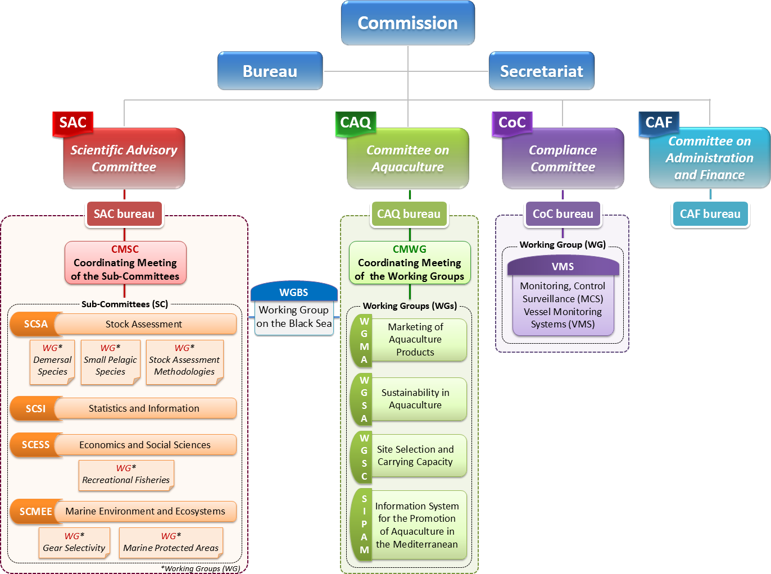
GFCM functioning
The Committee on Aquaculture (CAQ) provide advice to the Commission
Full consistency with global FAO policies
Notes:
The Committee on Aquaculture provides advice to the GFCM Commission on matters related to aquaculture
CAQ is coordinated by a Bureau and works through Working Groups since 2006
CAQ objective:
Monitor trends and promote the sustainable development and responsible management of marine and brackish water aquaculture in the region, and provide independent advice on the technical, socio-economic, legal and environmental issues:
assess information provided by Members and relevant aquaculture related stakeholders or programmes on production statistics, market data, culture systems, technologies used, farmed species, and maintain related databases, including relevant socio-economic, environmental, biotic and abiotic indicators;
promote the formulation of common standards and guidelines on sustainable development and responsible management of aquaculture;
identify cooperative research and training programmes and coordinate their implementation;
carry out other duties, functions or responsibilities related to aquaculture promotion as be conferred by the GFCM Commission.

Slide 23
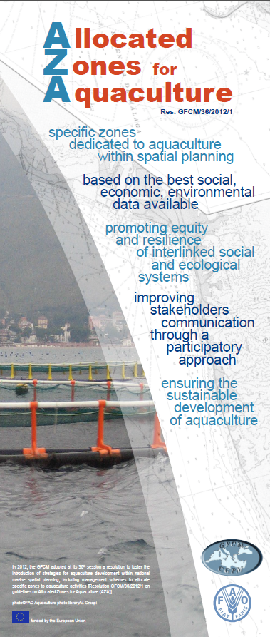
Working Group on Site Selection and Carrying Capacity (SHoCMEd project)
Developing site selection and criteria for the integration of aquaculture within coastal areas
Resolution GFCM/36/2012/1 on “Guidelines on allocated zones for aquaculture (AZA)”
Developed a harmonized environmental monitoring programme (EMP)
Definition of environmental quality standards (EQS)
Technical support and national capacity-building on identifying and establishing AZA
  Increasing uptake at the international level of the GFCM Resolution on AZA
Notes:
SHOCMED co-funded by EU
SHOCMED aims, inter alia, to produce criteria for enhancing integration of aquaculture in Integrated Coastal Zone Management (ICZM) by improving site selection and holding capacity benchmarks and reference points. This will be a base for harmonising standards and, as appropriate, aquaculture policy and legal frameworks across the Mediterranean, ensuring equal terms of competition and minimal environmental damage.
SHoCMed achievements comprise:
the GFCM Resolution on AZA
an environmental monitoring programme for AZA
a list of environmental quality standards
knowledge outputs
awareness raising and regional capacity building on site selection and carrying capacity
Resolution GFCM/36/2012/1 on “Guidelines on allocated zones for aquaculture (AZA)” was adopted during the 36th Session of the Commission (May 2012, Marrakech, Morocco)
it is the basic framework able to steer GFCM Members in establishing AZAs and developing aquaculture at a regional level
invite countries to introduce a strategy for aquaculture development in national marine spatial planning, including management schemes for the identification and allocation of specific zones reserved for aquaculture activities
need to follow-up on the implementation of the resolution at national level and monitor the implementation of AZA-related measures according to the guidelines provided
Produced Guidelines on a harmonized environmental monitoring programme (EMP) for marine finfish cage farming in the Mediterranean and the Black Sea which go along with AZA
the EMP draws inspiration from the different documents and outcomes produced within the SHoCMed project activities, the results of ad hoc meetings and the collaboration with GFCM partners and CAQ network of experts and research institutes
it comprises the scope and objective of an EMP, the essential information to be collected and the sampling design, EMP responsibility, as well as a glossary of the most common terms related to an EMP

Slide 24
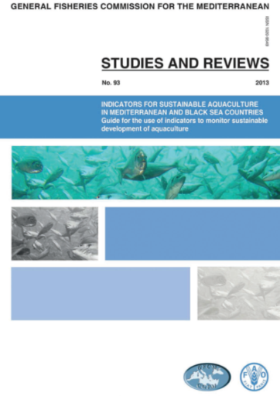
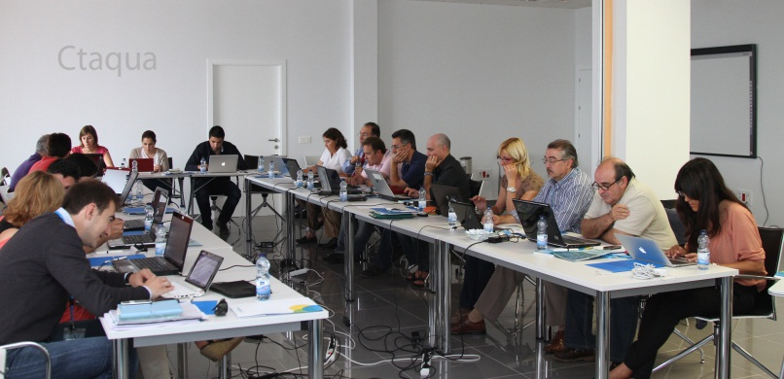
Working Group on sustainability in aquaculture (indam project)
An EAA general framework
Regional indicators and specific national indicators have been identified to monitor the development of aquaculture and improve communications (environmental; social; economic dimensions and governance)
A participatory, multidisciplinary and ecosystem approach (pilot studies)
Definition of standards and reference points
Guide for the use of indicators to monitor the sustainable development of aquaculture
Notes:
INDAM co-funded by EU
InDAM aims, inter alia, to provide policy-makers and relevant stakeholders with a comprehensive decision-support tool for sustainable aquaculture development in the Mediterranean, with a participatory and interdisciplinary approach. The tool’s efficacy is based on production of indicator sets and relative reference points and standards to guide, evaluate and provide incentives towards sustainable development of Mediterranean aquaculture in social, economic, environmental and governance dimensions, in an ecosystem-based framework. Co-construction of indicators aims to increase their prospects of implementation
Main outcomes of InDAM include:
a proven participatory methodology to identify and select indicators
pilot studies in several countries to test and ease the adoption of indicators
a pool of indicators at the disposal of countries
knowledge outputs

Slide 25

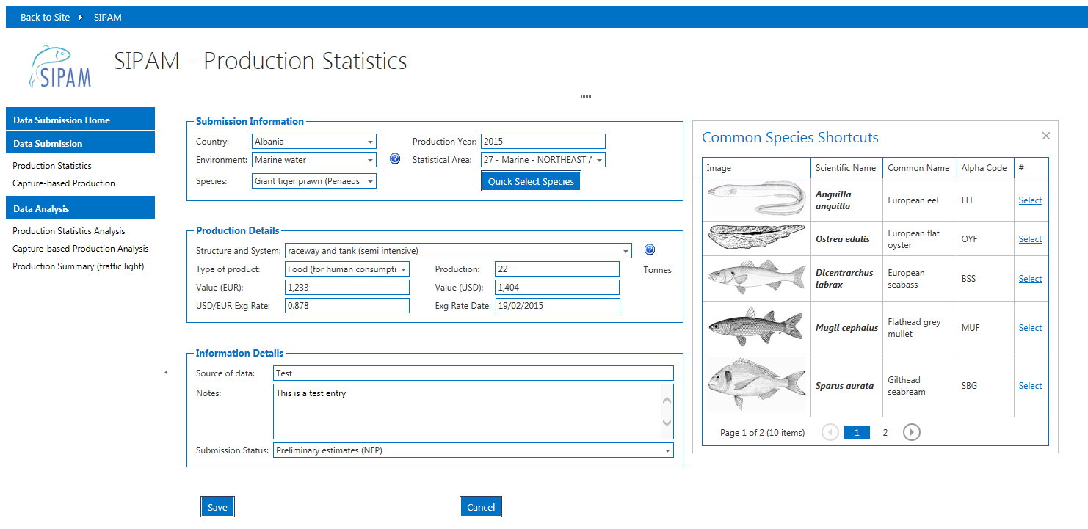
Information System for the Promotion of Aquaculture in the Mediterranean (SIPAM)
  Provide the IT environment for the sake of data transmission and processing of aquaculture statistical data by the network of National Focal Points (NFPs) in line with the recommendation GFCM/35/2011/6 on aquaculture data reporting
  Production statistics
  Production centers
  Capture- based aquaculture
  Links with other FAO databank (NASO – NALO - FAOLEX)
  Close collaboration with the FAO Coordinating Working Party on Fishery Statistics (CWP) and Eurostat

Slide 26
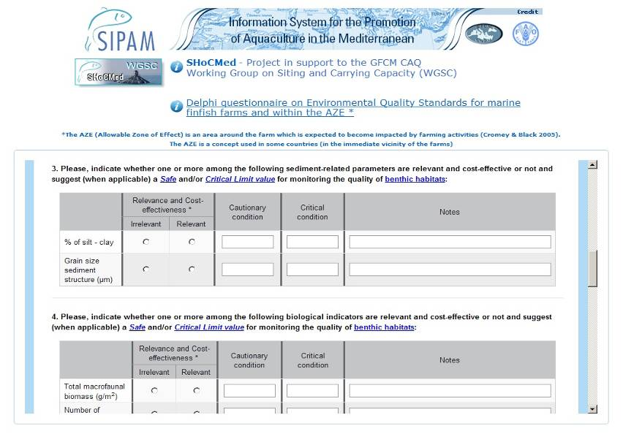
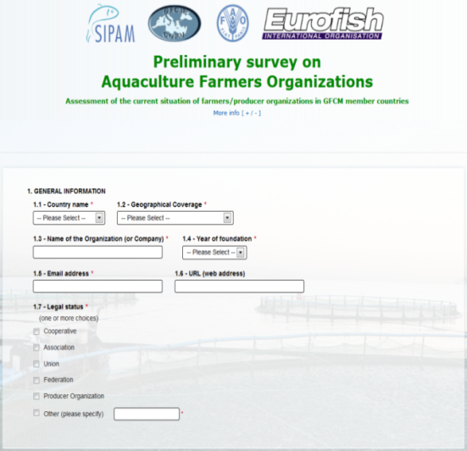
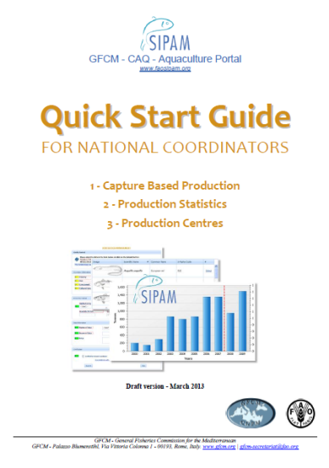
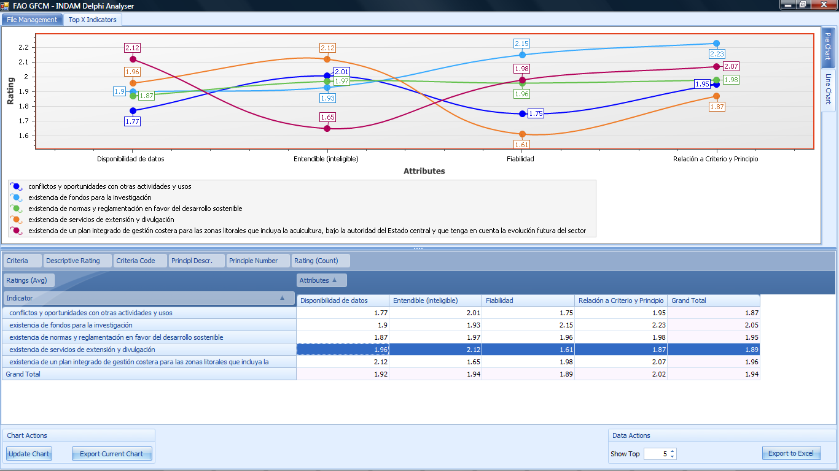
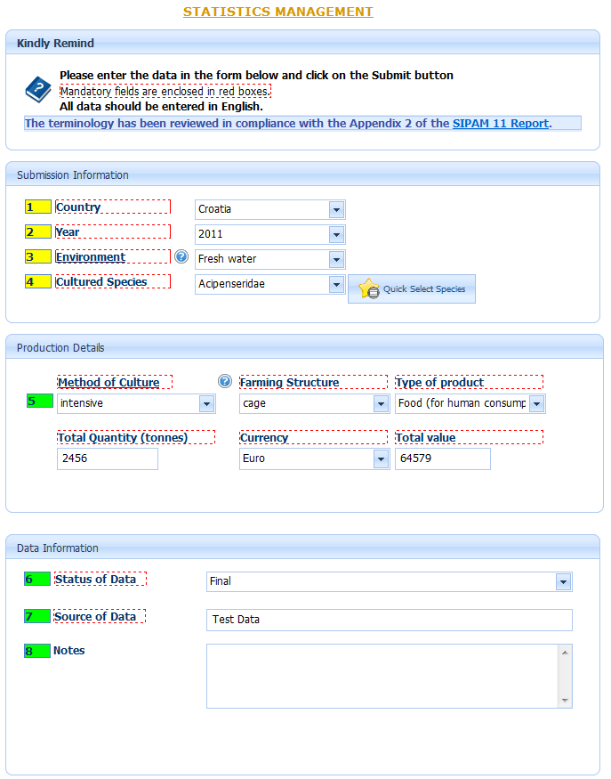
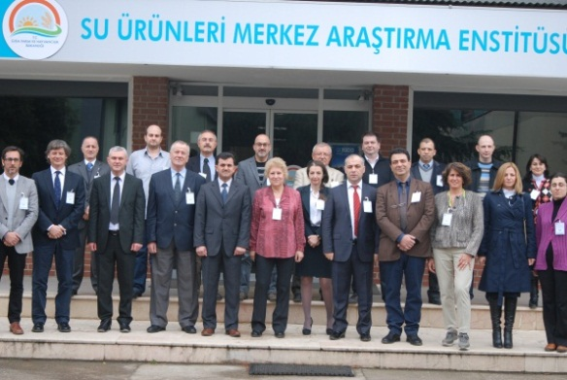
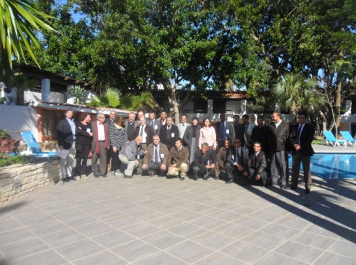
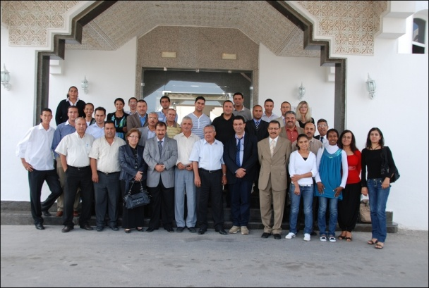
TECHNICAL Doc - INFO SYSTEMS – networks
GUIDELINES
TRAINING / WORKSHOPS
ON LINE DATA SUBMISSSION -SURVEY

Slide 27
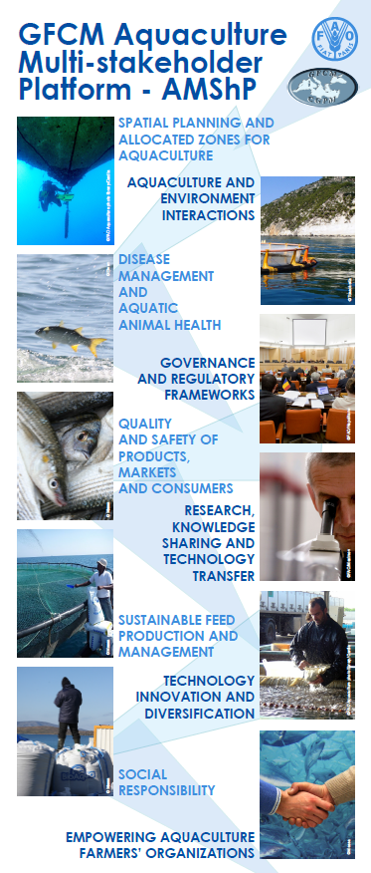
The GFCM Aquaculture Multi-Stakeholder Platform (AMShP)
Based on four thematic forums according to ten strategic areas
Contribute to the CAQ technical advice to the GFCM on aquaculture
Facilitate the involvement of a wide array of stakeholders
Working space for dialogue, cooperation and share knowledge and initiatives
Support innovation, knowledge transfer and capacity-building
Foster dialogue between aquaculture and other economic sectors
Notes:
GFCM Aquaculture Multi-Stakeholder Platform (AMSHP)
In 2013 the GFCM has launched the regional aquaculture multi-stakeholder platform (AMShP), building on the outcomes of the FAO-GFCM work on aquaculture and the EU funded AQUAMED project. The AMShP aims at bringing together institutional decision-makers and administrations, aquaculture industry and farmers, as well as research institutions in order to cooperate on aquaculture priorities and needs in the region.
Based on four thematic forums according to ten strategic areas, the multi-stakeholder platform act as a consultative body in the form of a regional hub to allow knowledge sharing, mobilization of human and financial resources, cooperation in research activities, as well as formulating and encouraging R&D coordination and projects of common interest.

Slide 28
Aquaculture-Environment Issues
Jose Aguilar-Manjarrez;
Jon Grant;
Joao G. Ferreira, Richard Corner, J.P. Nunes;
Suzanne Bricker.
Perspectives, past experience, and plans for AquaSpace.

Slide 29
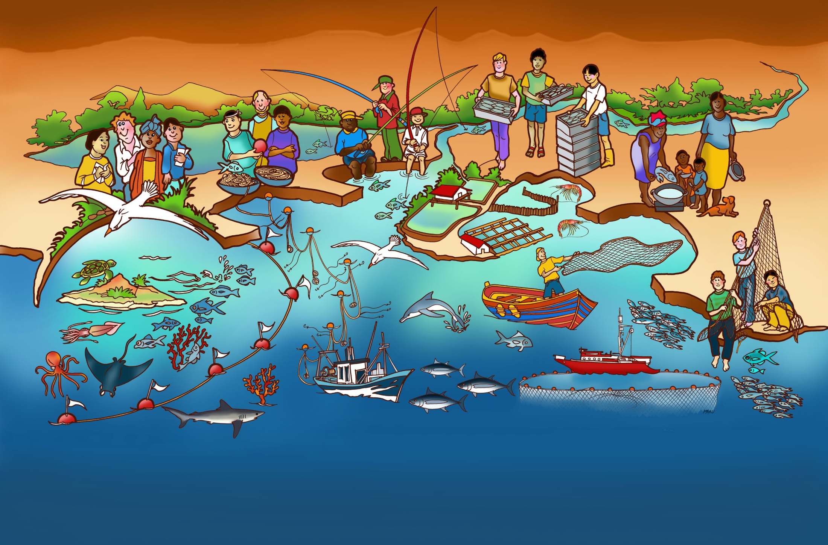
GUIDING PRINCIPLES
ECOSYSTEM APPROACH TO AQUACULTURE

Slide 30
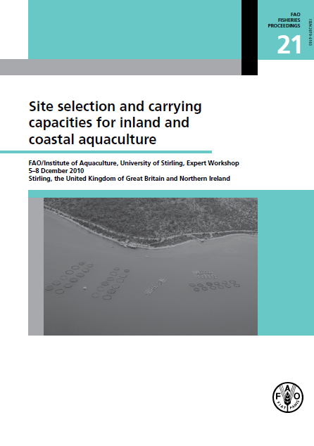
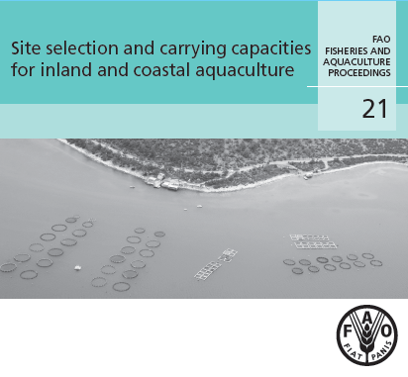
Site selection and carrying capacity
Ross, L.G., Telfer, T.C., Falconer, L., Soto, D. & Aguilar-Manjarrez, J., eds. 2013.
Site selection and carrying capacities for inland and coastal
aquaculture.
FAO/Institute of Aquaculture, University of Stirling, Expert
Workshop, 6–8 December 2010. Stirling, the United Kingdom of Great
Britain and Northern Ireland.
FAO Fisheries and Aquaculture Proceedings
No. 21. Rome, FAO.

Slide 31
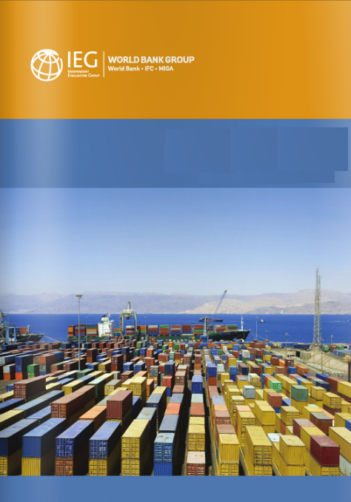

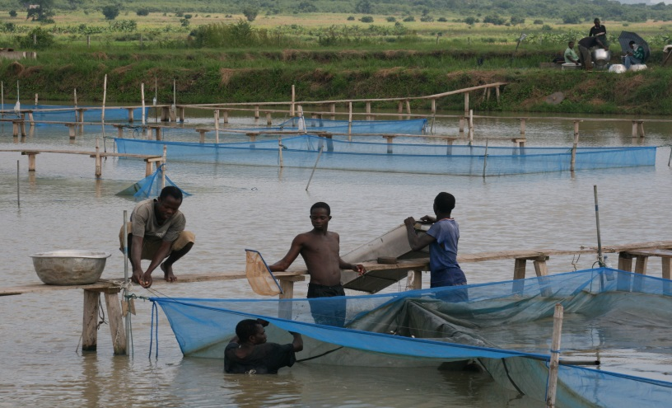
NEW publication in preparation:
Aquaculture zoning, site selection and area management
Aquaculture zoning, site selection and
area management under the ecosystem approach to aquaculture
Source: Soto, D., Aguilar-Manjarrez, J., Brummet, R. and White P. (in prep)

Slide 32
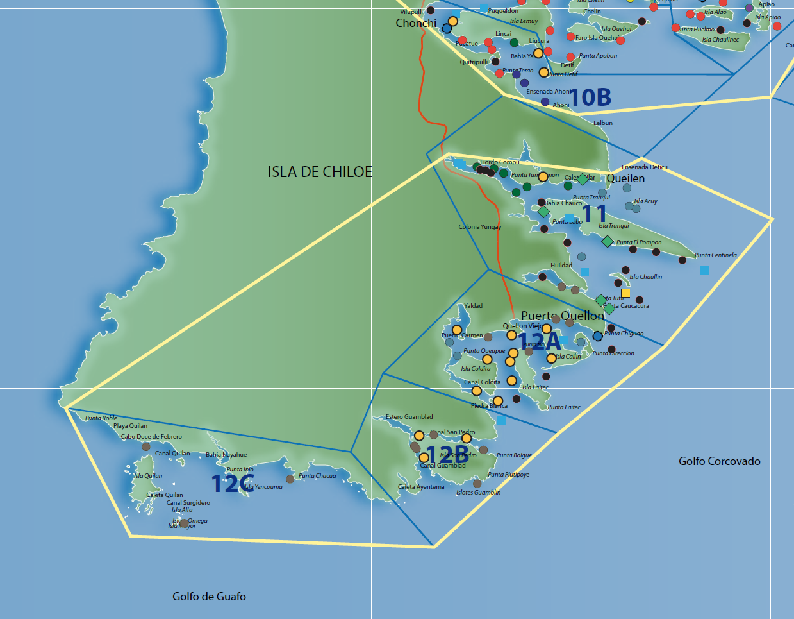
Zone
Aquaculture
management areas
Fish farms
Notes:
Definition of key terms for spatial planning

Slide 33
Planning and management
Zoning
Carrying capacity
Site
selection
Scoping
Area
management
Monitoring and review
Spatial plans and sustainable management practices
Notes:
Spatial planning is a dynamic process

Slide 34

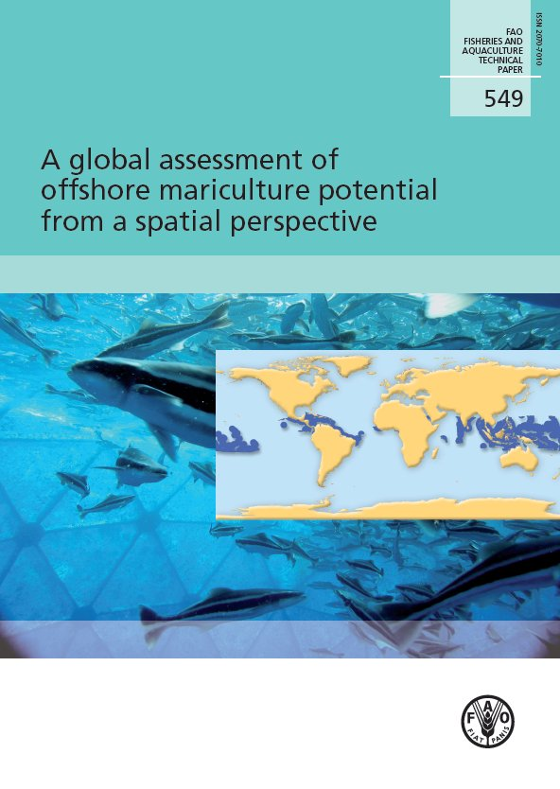
Offshore mariculture
Issue
There is a growing need to transfer land-based and/or coastal aquaculture production systems farther offshore to increase the availability of fish and fishery products for human consumption.
Applications
  global and regional suitability assessments
  site selection and zoning
  monitoring
Source: Kapetsky, Aguilar-Manjarrez and Jenness (2013); Dean and Salim (2013)
Notes:
Cover illustrations:
Map: Areas (dark blue) within Exclusive Economic Zones with temperatures favourable for offshore grow-out of cobia, Rachycentron canadum.
Photo: Cobia in submerged Aquapod net pens at the former site of Snapperfarm, Puerto Rico (courtesy of Ocean Farm Technologies Inc.).
Issue:
There is a growing need to transfer land-based and/or coastal aquaculture production systems farther offshore to increase the availability of fish and fishery products for human consumption

Slide 35
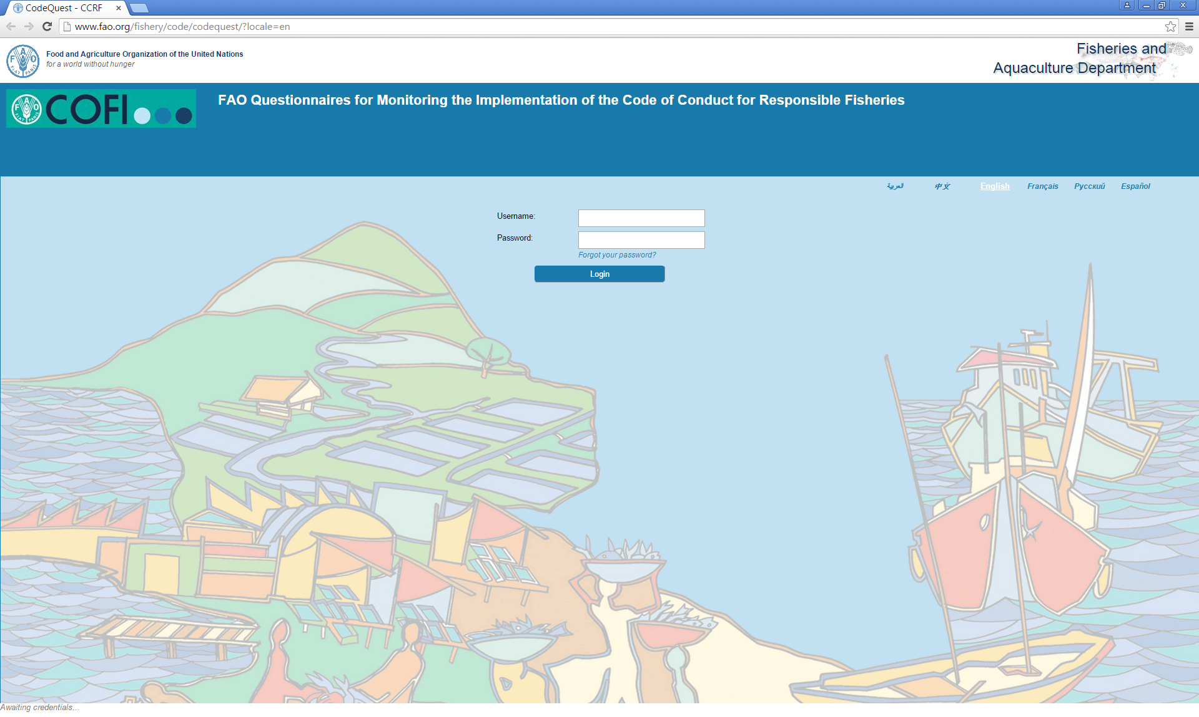
Notes:
Responses from the CCRF questionnaire contain many entries related to spatial planning.

Slide 36
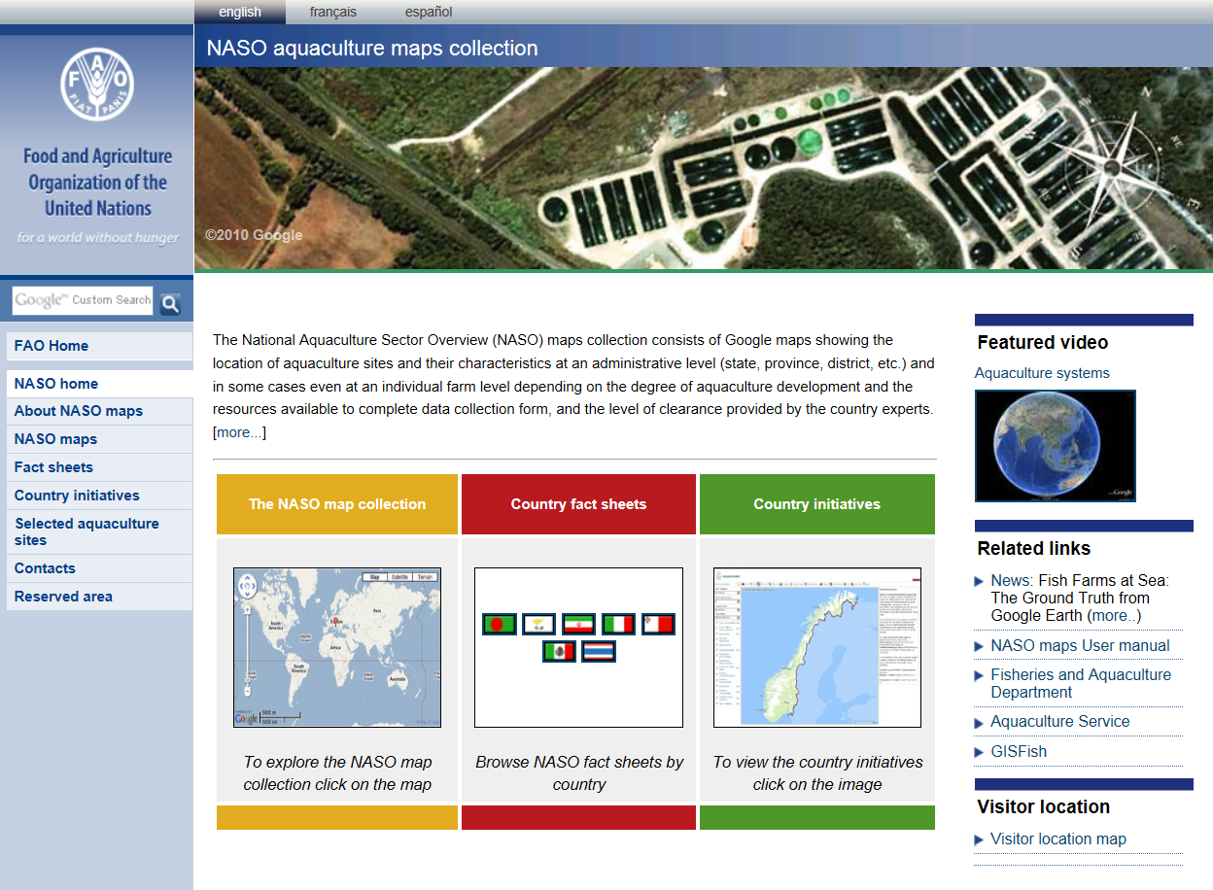
Notes:
http://www.fao.org/fishery/naso-maps/naso-home/en/

Slide 37
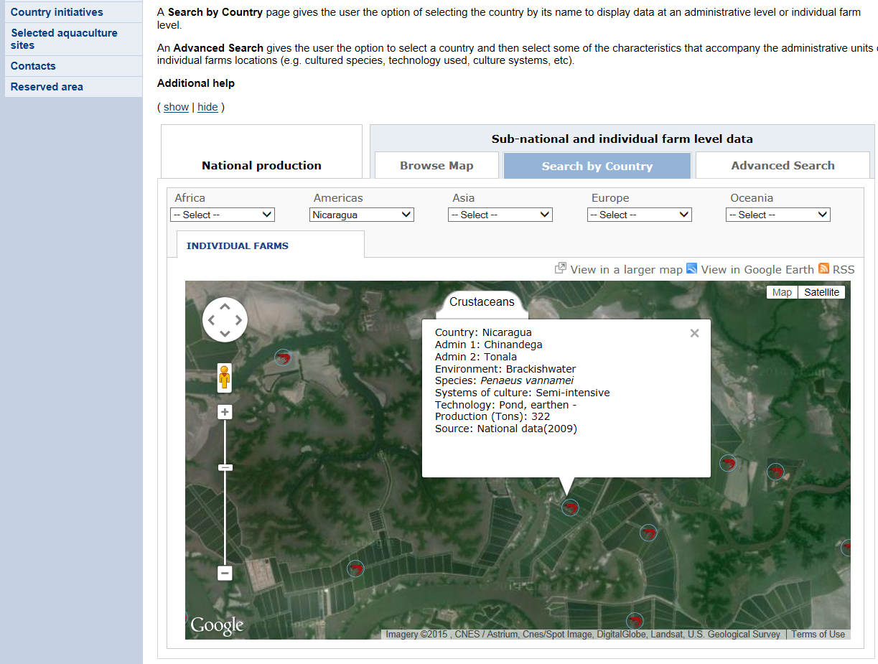

Slide 38
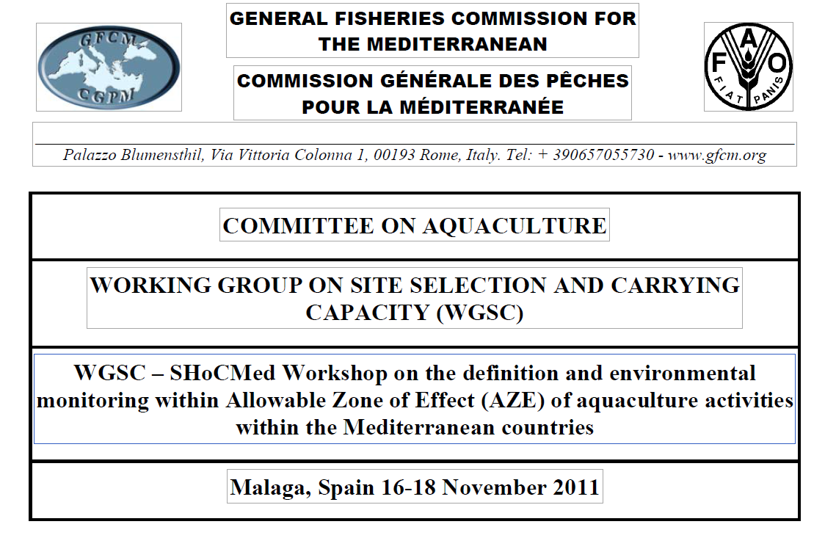

Slide 39
AZE = Allowable Zone of Effect
Establishing AZE requires spatial accuracy for the mooring of fish farms and the shape of AZE could follow a mix of administrative process and dispersion model. The use of mathematical models to incorporate AZE-EQS should be considered;
Once AZE is defined, environmental quality objectives should be identified, and the use of several reference/control sites is needed;
Marine Spatial Planning as a tool for a better integration of multiple uses in coastal zone
should be employed;

Slide 40
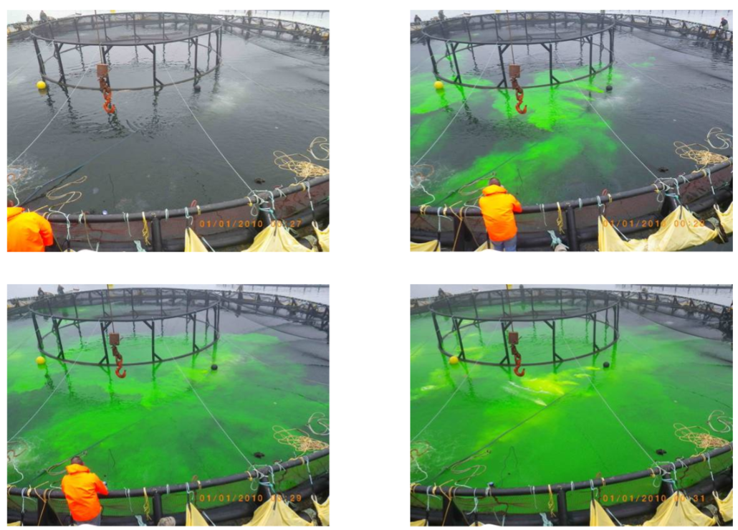
DFO dye studies in support of pest control zone of influence

Slide 41
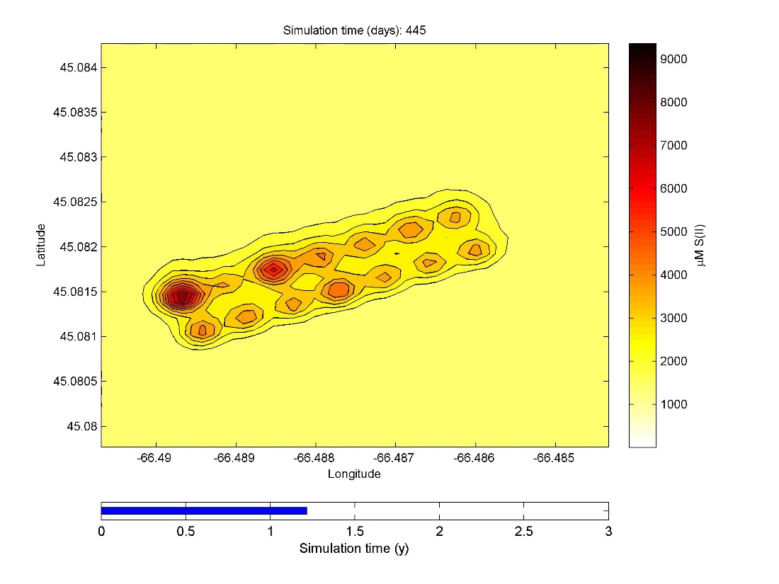
Model results:
Benthic zone of influence
from aquaculture food/feces

Slide 42
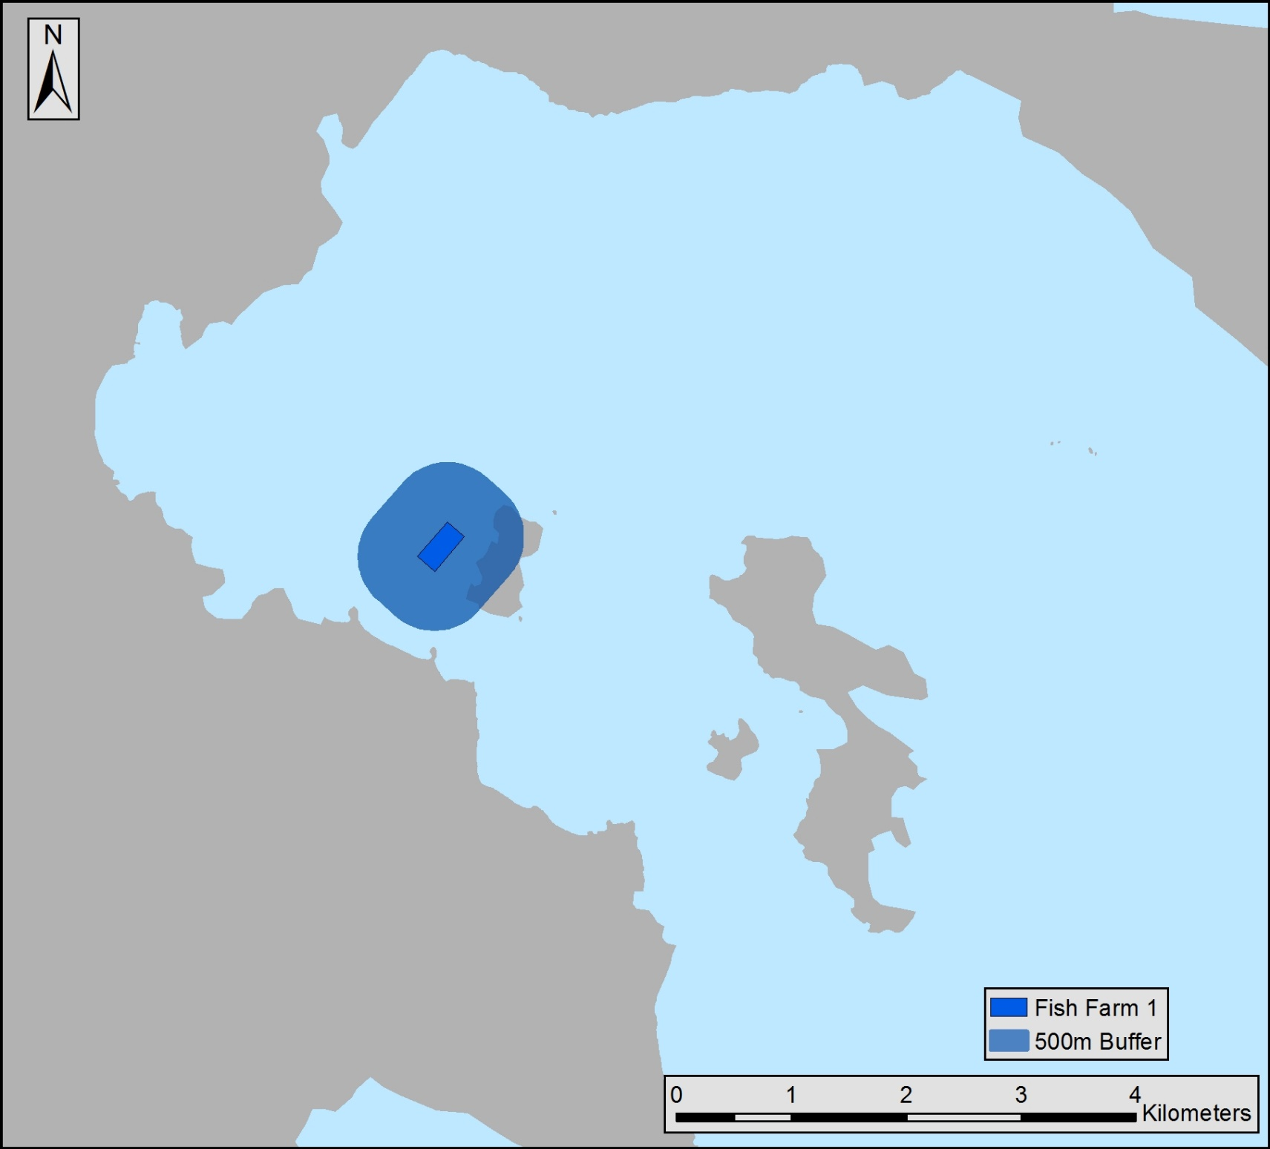
MSP Scenario
Arbitrary zone of Influence (ZOI): 500 meter buffer
Not representative of reality
ZOI better defined by:
Spatial extent and intensity of activity
Oceanographic models (i.e., currents)
Ecosystem models (i.e., nutrients)

Slide 43
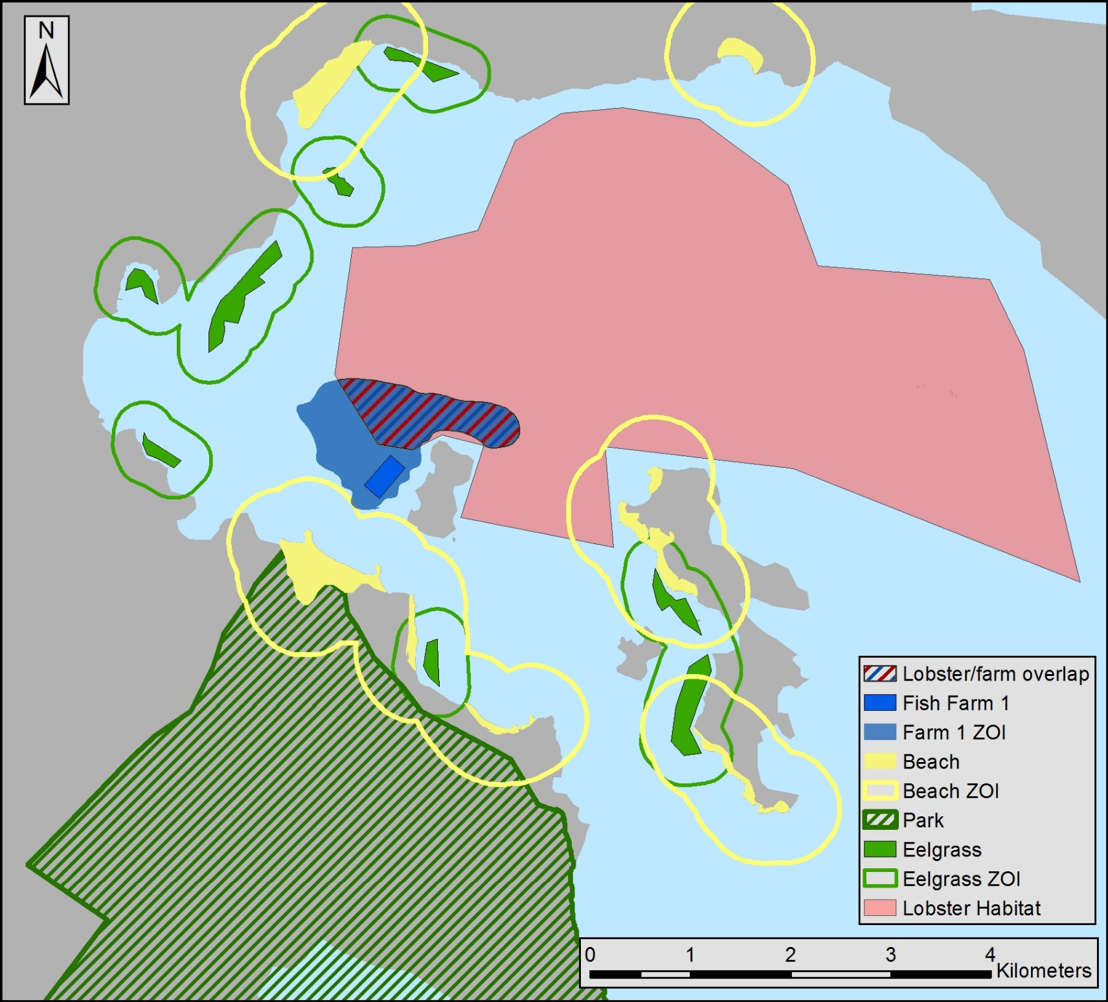
MSP Scenario
Farm/Lobster: 75 hectares
Lobster -> Farm: neutral
Farm -> Lobster: negative???; affecting 3.75% of the resource/habitat
Farm/beach: <0.1 hectares
Beach -> Farm: neutral
Farm -> Beach: negative???; negligible effects

Slide 44





Merging modeling and mapping to improve shellfish aquaculture site selection
Suzanne B. Bricker, Julie M. Rose, Tessa Getchis, Cary Chadwick, Cori M. Rose
Prepared for:
AquaSpace Kickoff Meeting
March 23–25, 2015
SAMS, Scottish Marine Institute, Oban

Slide 45
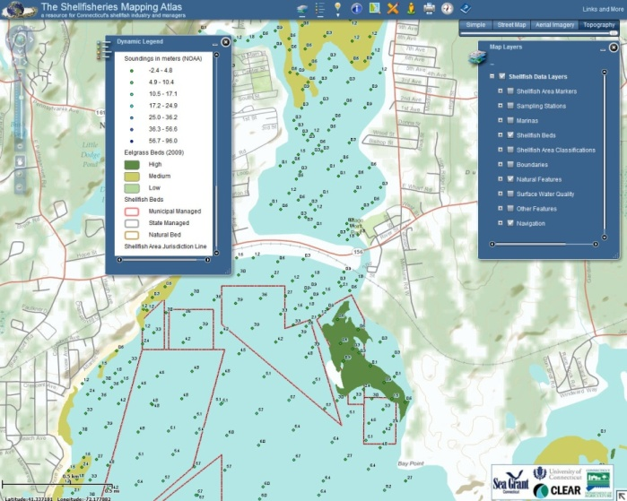
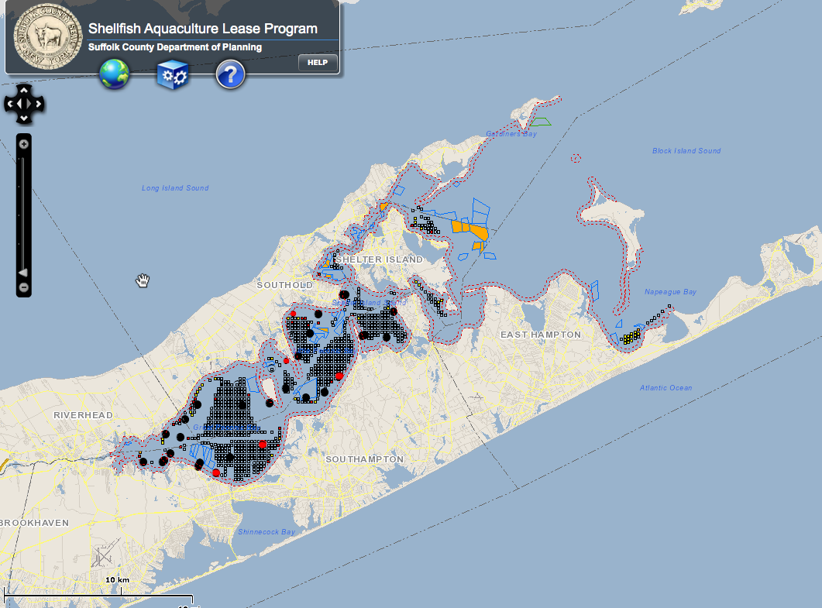
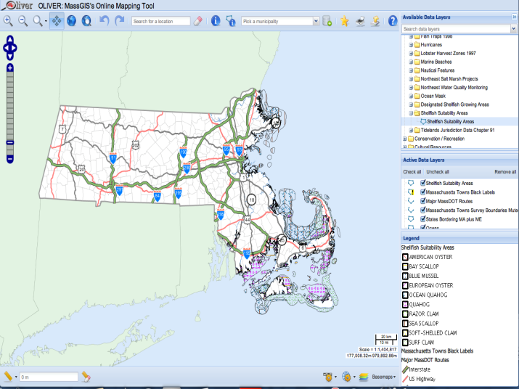
Mapping and site selection
GIS technology has given farmers and regulators the ability to visualize and minimize potential use conflicts
Maps are becoming increasingly available
(GIS decision support examples from US)
Connecticut Aquaculture Mapping Atlas
New York Shellfish iMap
Massachusetts Online Data Viewer

Slide 46
Benefits of a combined approach
Mapping does not address production potential - will the target organism grow? At what rate?
Integrated, mapping + modeling allows users to simultaneously address social, environmental, economic factors towards an improved decision-making process
Responsible growth: expand into areas that are best suited for shellfish production without use conflicts

Slide 47
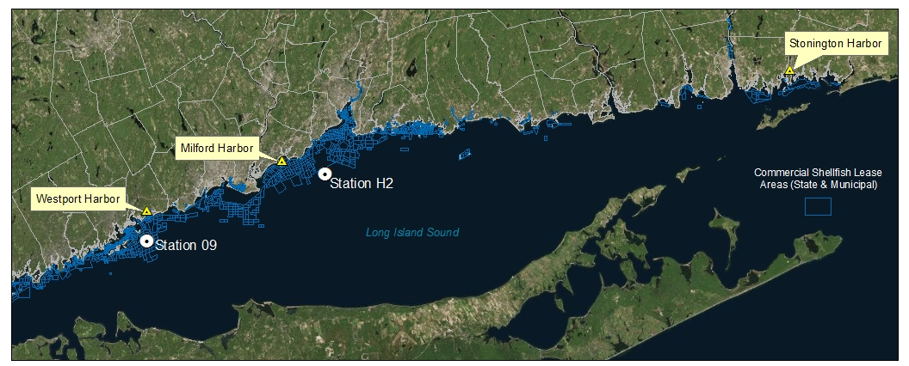
Pilot Study – Connecticut waters of Long Island Sound
Environmental Inputs to FARM model
Temperature, salinity, dissolved oxygen, chlorophyll, particulates, current speeds
Sampling Details
Milford: Monthly for a year
Westport & Mystic: May-September
Station 09 and H2: Long-term water quality monitoring stations; >15 years data

Slide 48
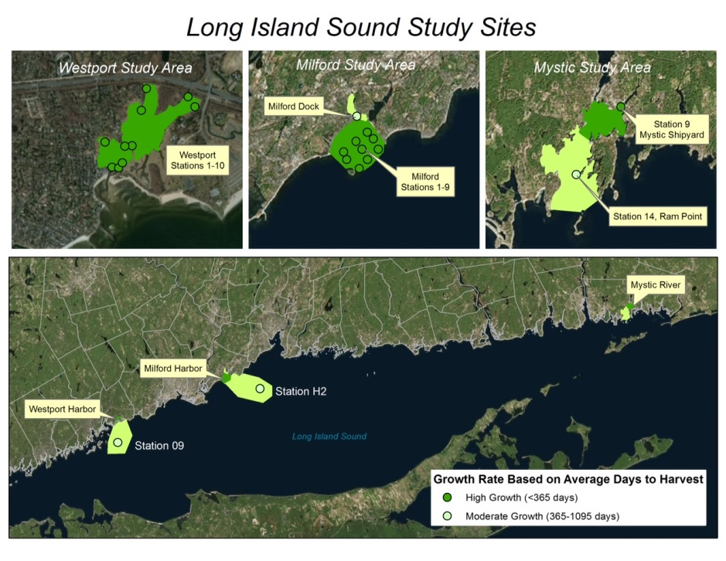
Results for pilot locations:
Additional GIS layer for Siting Tool
Bricker et al. Merging Modeling and Mapping: The integration of ecosystem-based models into an existing interactive web-based tool for improved aquaculture decision making. In Review, Aquaculture

Slide 49
Marginal analysis
FARM model – application to Samish Island Manila clam farm
300
TPP (tonnes)
APP
MPP
50
280
40
260
240
Present seeding
30
220
200
APP and MPP (no units)
Harvestable biomass (tonnes live weight)
20
180
VMP = MPP.Po
VMP = Pi
MPP = Pi/Po
Pi = 40 USD
Po = 5.1 USD
Optimal MPP = 7.84
10
160
140
0
120
9.5 tonnes of seed
100
-
10
2
4
6
8
10
12
14
16
Seed (tonnes)
Site selection strongly benefits from application of dynamic models.

Slide 50
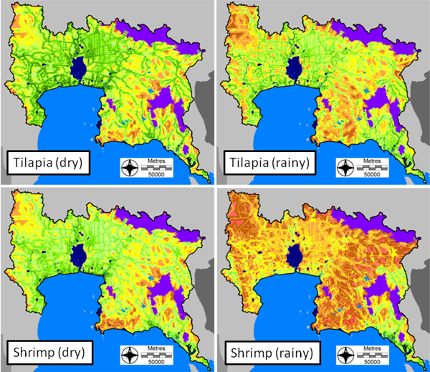
Site suitability analysis for pond culture in Thailand
MCE based on slope, pH, land use, water temperature, water availability, towns and roads.

Slide 51
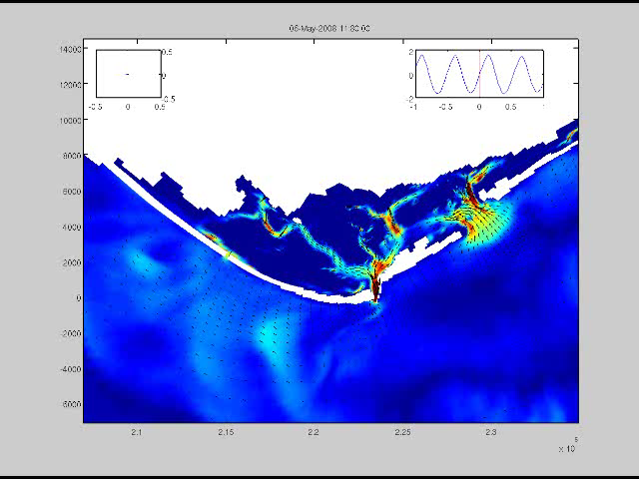
Connectivity: Offshore- Ria Formosa (circulation model)
Tidal circulation in the Ria Formosa, Algarve. Water residence time of 1-2 days.

Slide 52
Aquaculture-Other Sector Interactions
Karen Alexander;
Roberto Pastres & Daniele Brigolin;
Vanessa Stelzenmüller;
Øivind Bergh;
Chen Wang.
Perspectives, past experience, and plans for AquaSpace.

Slide 53
(iii) Aquaculture-Other Sector Issues
‘Social license’
  2 levels: approval (having favourable regard) and acceptance (disposition to tolerate)
Lack of stakeholder & general public knowledge/misinformation regarding spatial impacts of aquaculture
  E.g. environmental footprint of installation, visibility of installation, impacts on house prices & tourism
Perceptions of wilderness vs industrialisation

Slide 54

WP2
Task 2.3 –Assessment of Aquaculture-Other Sector Issues (Lead FAO)
Roberto Pastres pastres@unive.it
Daniele Brigolin brigo@unive.it

Slide 57
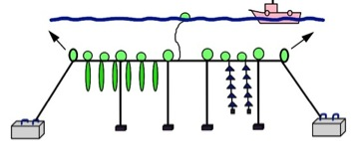
Multicriteria analysis
Multicriteria analysis
Satellite data
Simulation models
Interaction analysis
GIS
Scenarios may include:
Moving off-shore (> 3NM) existing farms ;
Diversifying production;
Combining shellfish and energy production (wind farm).
Areas to be allocated to aquaculture
Sistema a long-line monoventia (Bonardelli, 2013).

Slide 58
Example of the results obtained in the Adriatic Sea for mussel and oyster culture

Slide 59


- Development of marine aquaculture in Algeria
- Bejaia province identified as an area of interest for the development of marine aquaculture
- Potential conflicts-synergies with other uses: tourism, navigation, segrass meadows-MPAs

Slide 60

Stepwise approach
Step 1
Step 2
Step 3
Preliminary assessment of the allowable zone of effect

Slide 61

Step 3. FiCIM (Fish cage integrated model)
FiCIM:
(Brigolin et al., 2014. Aquaculture Environment Interactions)
4modules:
- Seabass/seabream individual bioenergetic model
- Population dynamics
- Particle-tracking
- Organic matter mineralization
Implementation: Coded in FORTRAN; ODE solved RK4th; Lagrangian eq. (Jusup et al., 2007)

Slide 62

Space for aquaculture ? (white areas)
Site B
Site A

Slide 63

ICES ASC – Session I – 09/24/2013
Development of guidance for better integration of aquaculture, fisheries and other activities in coastal waters
Stelzenmüller, V.*, Schulze, T., Sell, A., Gimpel, A., Bergh, O., Soma, K., Ferreira J., Saurel, C., Gault, J., O’Hagan, A.M., Bolman, B., Vale, C., Laurans, M., Fabi, G., v. Oostenbrugge, H., Mäkinen. T., Verner-Jeffreys, D. and Bello Gomez, E.
*vanessa.stelzenmueller@ti.bund.de, Thünen-Institute of Sea Fisheries, Hamburg, Germany

Slide 64
COEXIST case study areas

Slide 65
Spatial management questions
16 Key questions on spatial management
Assessment of status quo (legislation, activities, conflicts and synergies)
How can main conflicts be characterised?
Where does or will co-use occur?
Monitoring and evaluation of spatial management options
What are the impacts of spatial management measures?
How can conflicts be quantified ?
…….
Integration of aquaculture, fisheries and other sectors
What are relevant parameters for aquaculture species?
What is the optimal aquaculture practice?
……
……

Slide 66


Spatial management tools
Tool fact sheets

Slide 67

CS Illustrations
Monitoring and evaluation of spatial management options

Slide 68

Cross case study comparison
Standardised assessment of conflicts and synergies
D5.1: coexistproject.eu/images/COEXIST/deliverables/WP5/COEXIST_245178_D5.1_Final.pdf

Slide 69
Cross case study comparison
Standardised assessment of conflicts and synergies
D5.1: coexistproject.eu/images/COEXIST/deliverables/WP5/COEXIST_245178_D5.1_Final.pdf

Slide 70
Cross case study comparison
Size (extent) of a case study is not necessarily indicative of the level of potential conflict
Large scale and permanent conflicts often involve fisheries and aquaculture sectors due to the nature of these activities and their spatial overlap
Observed synergies between activities included beneficial working relationships, co-use of an area, knowledge transfer between sectors, coordinated action and education and stakeholder facilitation

Slide 71

Aquaculture – impact on pathogens
Pathogen reservoirs in wild organisms -
Pathogens proliferates in aquaculture
Movement of cultured organisms: vectors for pathogens

Slide 72

Disease
Most significant limiting factor in aquaculture
Direct impact: mortality
Pathogens can be amplified within farm, causing significant infection pressure towards wild stocks
Aquaculture and coastal management practices influence the transmission and impact of pathogens

Slide 73
We do know:
Diseases are an integral part of nature
Pathogens are subject to evolution, thus diseaes are, too
There is no such thing as a disease-free wild population
Absence of pathogens: a situation only existing in an imaginary world of some environmental NGO´s.
Human behaviour affect proliferation and distribution of pathogens in the wild

Slide 74
Lessons learned
Knowledge based on experience
  Often very expensive ”learning”
    Introductions of diseases.
    Uncontrolled proliferation of diseases
Models learned from culture of other species
  Adapt the models
    to the marine environment
    to bivalves

Slide 75
Exchange of pathogens wild-farmed
Integration of models and processes
Persistance
Natural reservoir
Vectors:
Migration of wild organisms
Ballast water
Wild organisms
Lower host density
Introduced
pathogens
Vector:
Transport of farmed organisms
Farmed organisms
High host density
Proliferation of pathogen
Enhancement of virulence?

Slide 76
Compartment-based models:
Individuals transcend through a series of states
  Susceptible
  Infected
  (potentially) back to susceptible
Maximum host carrying capacity – critical threshold N_{t}
  = maximum number of susceptible individuals
  - total number of individuals is N
In aquaculture N_{t}/N can be manipulated

Slide 77
Network-based models
Take into account the contacts between populations that actually DO take place:
  Movement of populatons
  Movement of people
  Movement of equipment
  Movement of water
  Movement of other vectors

Slide 78
Examples of tools
Distance between farms
Maximum amount of animals per farm
Maximum impact on environment
Fallowing
Restriction on movement of animals
Restrictions on sources of juveniles
    Specific-pathogen-free quality
    Screening for pathogens

Slide 79


Seascapes: Multi-Sectoral Uses
WP2
Visibility of land from the sea
Visibility of land from the sea
Landscape character: biophysical and experiential elements – used by public agencies in assessing development proposals
Landscape concepts provide framework for assessments
Seascape characteristics: spatial modelling – including visibility
Input to spatial planning; other sea uses; link sea and land use impacts; transferrable across study sites

Slide 80



Seascape: Multi-Sectoral Uses
WP2
Visibility of sea from the land
Visibility of surfaces: land and sea, across coastline
Other factors: enclosure by terrain height
Link spatial planning – land and marine
Add sectors – natural heritage designations, sensitive views, zoned uses
Identify opportunities
Positive planning of aquaculture into local context.

Slide 81


Multi-Sectoral Uses: Perceptions
WP2
Test public ‘seascape’ preferences (extension of ‘landscape preferences’) – responses to changes in seascape character using visualisation and preference modelling
Landscape concepts of likely interest –
  Ephemera (e.g. cloud, weather, lighting/illumination)
  Disturbance (e.g. change in content inconsistent with landscape/ seascape)
Develop evidence base of preferences with respect to cultural heritage, and seascape characteristics.

Slide 82


Stakeholders: Knowledge Exchange and Communications
WP2 & WP6
Oban
Virtual Landscape Theatre: stakeholder dialogue and opinion sharing
Oculus rift: single user exploration of seascapes (underwater environment)
Elicit opinions: facilitate stakeholder engagement, identification of opportunities, risks and sensitivities
Explore scenarios of aquaculture development: show alternatives
Introduce, explain, discuss options and impacts
Eliciting stakeholder opinions and supporting communications of scenarios of development using linked visualisation and other graphical tools.

Slide 83
Economic and Market Issues
Gergő Gyalog;
Rui G. Ferreira, Joao G. Ferreira.
Perspectives, past experience, and plans for AquaSpace.
Notes:
HAKI? NARIC?

Slide 84
Economics of site selection in pond aquaculture:
Input availability/prices and markets
Production economics: input prices, factor productivities
  land/water resources: cost and availability are highly dependent upon site selection (land quality, proximity to inlet canals, etc.); productivity is partly determined by quality of soil
  ex-farm inputs (feed, fuel, power): costs are determined by availability of infrastructure (roads, electric lines); proximity to upstream industry players (feed mills, seed suppliers)
  labour (incl. human skills): cost and quality of labour force are determined by local aquaculture traditions; proximity to education/research/extension centers; general entrepreneurship in the region
Market issues
  Proximity to markets/processing units, competing products
  Tradition of fisheries in the region, general fish consumption patterns
  Potential users of co- and by-products; marketing synergies with other operations

Slide 85
Economics of site selection in pond aquaculture:
Economic evaluation of new sites
New sites have to be suitable for running a profitable operation
Achievable profits have to be evaluated against:
  Profitability of aquaculture operations at other sites
  Potential profitability of alternative uses at the site in question
Profitability can be assessed either by
  Return on cost / Return on investment (returns on total inputs): €_{returns}/ €_{costs}
  Returns to a single factor (land or water): €_{returns} /hectare; €_{returns} /m³
Returns on cost ≠ Return per hectare (varying level of production intensity and yields)
In a resource constrained environment investment decisions are likely to be made on the basis of expected profitability on a single factor (profit/ hectare; profit/m³ water used)
  Availability of land; culture sites; space in water bodies; amount of supply water can be limited locally, regionally or at country-level

Slide 86
Task 2.4 –Assessment of Economic-Market Issues
Pond aquaculture
Data from 3 countries: HU, SR and PL/CZ/RO (still have to be decided)
Assessment of differences in input/resource prices
  by region, location
  by distance to canals and other infrastructure
Analysis of relationship between prevalent farming technologies and relative input prices
Analysis of non-market constraints for land and water (overlap with Task 2.1)
Review of factor productivity (land, water) for aquaculture and competing industries. Comparison between technologies and industries (overlap with Task 2.3)
Analysis of underlying principles that govern investors’ decision.
Assessment of viability of expansion in pond aquaculture

Slide 87
Economic and Market Issues
Competitiveness of European production on price : quality;
European costs are high compared to Asia and South America, partly due to labour costs, and partly due to environmental regulation;
Competition for inshore and inland space drives aquaculture offshore;
Although AquaSpace is focused on site selection, we need to consider how much can be grown at a site, i.e. carrying capacity, because that conditions economic viability;
For industry to develop it needs financial and regulatory instruments that shorten time to market, reduce costs, and provide capital;
AquaSpace will group these aspects into an investor-appeal index, which will include both policy and economic components.

Slide 88

Offshore aquaculture
Areas within 25 nautical miles (46.3 km) of a port
UK has120,000 km² that meet criteria for cages, longlines,and 25nm to port
Kapetsky et al., 2010. FAO Workshop, Rome, 2010.
Notes:
Use of GIS to determine offshore areas with potential for aquaculture. The example, from Kapetsky, Aguilar-Manjarrez, Jennes & Ferreira (In Press) shows the potential based on distance to a port, a proxy for transportation costs

Slide 89
Systems approach for site selection
Legal constraints
Geographic area selection
Generation of constraint maps
Base map generation
Suitable
areas
No
No suitability
Use conflicts
Yes
STAGE 1
Physical suitability
Data sources
Multi-layer factor generation
Growth and survival
Water quality criteria
Sediment quality criteria
Factor suitability ranges
Factor suitability
Every talk needs a horrendogram!
Product quality
Ecological quality criteria
Multi-criteria evaluation
Environmental
sustainability
No suitability
No
Suitable
areas
Yes
STAGE 2
No business viability
Site selection
No
Detailed analysis of production, socio-economics, and environmental effects
Yes
Production feasibility
Farm-scale carrying capacity model
Environmental driver data or system-scale model outputs
Silva et al., 2011.
STAGE 3

